Slide 1
CSN 102: Data Structures
Linked List: List, Dynamic Memory Allocation, SLL, Polynomial Addition, Sparse Matrices, Garbage Collection, Circular LL

Slide 2
Abstract Data Type (ADT)
An Abstract Data Type is:
Set of values
Set of operations which can be uniformly applied to these values
Set of Axioms

Slide 3
List Abstract Data Type
List ADT has:
Values based on what type of data list stores
Main operations:
new() : creates a new list
prepend(L, key): add element key to front of list L
append(L, key): add element key to end of list L
remove(L, key): removes element key from list L
search(L, key): find location of element key in L
head(L): returns the first object in L
isEmpty(L): checks whether list L is empty or not

Slide 4
Drawbacks with Array
Problem: An array has a limited number of elements
Routines inserting a new value have to check that there is room
Solution: Multiple solutions exist
Increase the size of array with some constant each time array is full
Double the size of array each time array is full
Use Linked List data structure

Slide 5
Linked List(LL)
Nodes stores the data/values
Sequence of nodes; each node points to next node in list
Add node dynamically when required
Can store infinite data until memory of system is exhausted
LL might have a header to start node. Eg. myList
Last node contains a null link
myList
a
b
c
d

Slide 6
Dynamic Memory Allocation(1)
Allocate memory to elements one at a time as needed, have each element keep track of the next element
Result is referred to as linked list of elements, track next element with a pointer

Slide 7
Dynamic Memory Allocation(2)
malloc and calloc are two functions for dynamic memory allocation
Malloc() is used to allocate a block of memory dynamically. It reserves memory space of specified size and returns the null pointer pointing to the memory location.
Calloc() function is used to allocate multiple blocks of memory.
TypeCast void pointer to use memory as required data type
ptr = (cast_type *) malloc (byte_size);
ptr = (cast_type *) calloc (n, size);//n memory blocks of same size

Slide 8
More Terminology
A node’s successor is the next node in the sequence
The last node has no successor
A node’s predecessor is the previous node in the sequence
The first node has no predecessor
A list’s length is the number of elements in it
A list may be empty (contain no elements)
Linked list in context of C are sometime referred as List
Until not specified, linked list refers to Singly-Linked List

Slide 9
Creating a (Singly) Linked List
Type declaration:
typedef struct ESTRUCT {
DataType data; /*DataType is type for element of list */
struct ESTRUCT *next; /*Pointer to struct ESTRUCT*/
} Estruct ;
typedef struct ESTRUCT * Eptr;
Pointer to node:
struct ESTRUCT *ListStart;
Estruct *ListStruct;
EPtr ListStart;

Slide 10
Create LL with 3 Nodes
void main() { /*Assume data is int*/
Estruct first, second, third;
first.data = 5;
first.next = &second;
second.data = 9;
second.next = &third;
third.data = 6;
third.next = NULL;
Eptr ListStart = &first;
}

Slide 11
Deletion in LL
Delete a node from the LL from previous implementation
Delete first node
Set header to point second node
ListStart=&second;
Delete from middle
Set previous node to point node next to middle
first.next = &third;
Delete Last node
Set pointer of second last node to point NULL
second.next = NULL;

Slide 12
Issue with Implementation
Above strategy for node creation will work in main function
What would happen if we create a node in some function other than main?
Could not be accessible by other functions as limited by scope
Solution: use dynamic memory allocation

Slide 13
LL with 3 nodes (dynamic)
void main() { /*assume data is int */
Eptr ListStart = NULL; /*safe to give a legal value*/
ListStart = (Eptr)malloc(sizeof(Estruct));
/* ListStart points to memory allocated at location 108 */
}

Slide 14
LL with 3 nodes (dynamic)
ListStart->data = 5;
/*ListStart->data is equivalent to (*ListStart).data */
ListStart->next = NULL;
ListStart->next = (Eptr)malloc(sizeof(Estruct));
ListStart->next->data = 9;
ListStart->next->next = NULL;

Slide 15
LL with 3 nodes (dynamic)
ListStart->next->next = (Eptr)malloc(sizeof(Estruct));
ListStart->next->next->data = 6;
ListStart->next->next->next = NULL;
/* Linked list of 3 elements (count data values):
ListStart points to first element
ListStart->next points to second element
ListStart->next->next points to third element
and ListStart->next->next->next is NULL to indicate there is no fourth element */

Slide 16
Deletion from LL(dynamic)
Delete from LL in dynamic implementation strategy
Delete 6 from the previous list
/* To eliminate element, start with free operation */
free(ListStart->next->next);
/* NOTE: free not enough -- does not change memory
Element still appears to be in list but C might give memory away
in next request. Need to reset the pointer to NULL */
ListStart->next->next = NULL;
/* Element at 132 no longer part of list (safe to reuse memory) */

Slide 17
Common Mistakes
Dereferencing a NULL pointer
ListStart = NULL;
ListStart->data = 5; /* ERROR */
Using a freed element
free(ListStart->next);
ListStart->next->data = 6; /* PROBLEM */
sUsing a pointer before set
ListStart = (EPtr) malloc(sizeof(EStruct));
ListStart->next->data = 7; /* ERROR */

Slide 18
LL Using Functions
Certain linked list operations (init, insert, etc.) may change element at start of list (what ListStart points at)
To change what ListStart points to could pass a pointer to ListStart (pointer to pointer)
Alternately, in each such routine/function, always return a pointer to ListStart and set ListStart to the result of function call (if ListStart doesn’t change it doesn’t hurt)
pseudocode:
Eptr <function_name>(<input_parameters>) {
<some_processing>
return <pointer_to_struct>
}

Slide 19
Initialization of LL
Create an empty linked list pointing to null
Return a header pointer
Eptr initializeLL () {
return NULL;
}
main() {
Eptr ListStart = initializeLL();
}

Slide 20
Create New Node
Each time function is called, dynamically create a node and return pointer to it
Pass element and address to be stored
Eptr newNode (DataType ndata, Eptr nnext) {
Eptr newN = (Eptr) malloc(sizeof(Estruct)); /*new node*/
newN->data = ndata; /*set data of new node to ndata*/
newN->next = nnext; /*set next of new node to nnext*/
return newN; /*return pointer to new node*/
}

Slide 21
Insertion in Linked List
Involves two step:
Finding the correct position
Doing the work to add the node
Three possible positions:
Front
End
Somewhere in the middle

Slide 22
Insertion in Linked List (Front)
Finding the correct location
No work required as already known
Irrespective of list is empty or not, header will always point to correct location

Slide 23
Insertion in Linked List (Front)
Add new node to list
Save element in data field of new node
Eptr insertF(Eptr start, DataType nData) {
return newNode(ndata, start);
}
ListStart
New Node
5
9
6
X
3

Slide 24
Insertion in Linked List (Front)
Add new node to list
Save element in data field of new node
Make new node’s next pointer to point start of existing list
Eptr insertF(Eptr start, DataType nData) {
return newNode(ndata, start);
}
ListStart
New Node
5
9
6
X
3

Slide 25
Insertion in Linked List (Front)
Add new node to list
Save element in data field of new node
Make new node’s next pointer to point start of existing list
Make start of list point to new node in main
ListStart = insertF(ListStart, ndata);
ListStart
New Node
5
9
6
X
3

Slide 26
Insertion in Linked List (End)
Finding the correct location
Need a “walker” to “walk” down the list till end is reached
Eptr insertE(Eptr start, dataType ndata) {
Eptr last = start; /*last is walker variable*/
if (last == NULL) /*list is empty, add at start*/
return newNode(ndata, NULL);
else {
while (last->next != NULL) /*find last node*/
last = last->next;
last->next = newNode(ndata, NULL);
return start; /*start doesn’t change*/
}
}

Slide 27
Insertion in Linked List (End)
Find last of list
ListStart
5
9
6
X
Last

Slide 28
Insertion in Linked List (End)
Find last of list
Add new node to list
Save element in data field of new node
Save NULL in next field of new node
Make last node’s next pointer to point new node
ListStart
New Node
5
9
6
3
X
Last

Slide 29
Insertion in Linked List (Between)
Find the node you want to insert after
ListStart
5
9
6
X
After

Slide 30
Insertion in Linked List (Between)
Find the node you want to insert after
Add new node to list
Save element in data field of new node
Save address of following node in next field of new node
Save address of new node in “after” node
ListStart
New Node
5
9
6
X
3
After

Slide 31
Print a Linked List
Use a “walker” to examine list from start to end
void printList(Eptr start) {
Eptr temp = start; /*temp is walker variable*/
while (temp != NULL) {
print(temp->data);
temp = temp->next;
}
}
Why we need “walker” when we already have “start”?
Try to avoid start, could be required later in the function

Slide 32
Search in Linked List
Compare every element in list; return pointer to node if found else return NULL
Eptr findE(Eptr start, dataType findData) {
Eptr findP = start; /*walker*/
while(findP != NULL && findP->next == findData)
findP = findP->next;
retunr findP;
}
Can we perform binary search given elements are sorted?

Slide 33
Search in Linked List
Compare every element in list; return pointer to node if found else return NULL
Eptr findE(Eptr start, dataType findData) {
Eptr findP = start; /*walker*/
while(findP != NULL && findP->next != findData)
findP = findP->next;
retunr findP;
}
Can we perform binary search given elements are sorted?
Yes, but the performance will be similar to linear search

Slide 34
Search in Linked List
Search 9
Search 4
ListStart
5
9
6
X
findP
ListStart
5
9
6
X
findP

Slide 35
Deletion in Linked List
Involves two steps:
Find the node to be deleted
Change its predecessor to point its successor
Deletion from front
Change header to point to second node
Deletion from elsewhere
Change predecessor to point successor

Slide 36
Deletion in Linked List (Front)
Change the header to point to second node.
Set first node free
Eptr deleteF(Eptr start) {
Eptr temp = start;
temp = temp->next;
free(start);
return temp;
}
Set start to returned pointer after deletion
ListStart = deleteF(ListStart);

Slide 37
Deletion in Linked List (Except Front)
Change the predecessor to point to successor
Set deleted node free
Eptr deleteA(Eptr start, Eptr after) {
Eptr temp = after;
temp->next = temp->next->next;
free(after);
return start;
}

Slide 38
Linked List Variation: Dummy Head Node
Why?
No special case for inserting/deleting at beginning
Header (ListStart) does not change after it is initialized
Disadvantage
cost of one extra element

Slide 39
Linked List Variation: Sorted List
Idea: Keep the items on the list in a sorted order
sort based on data value in each node
Advantages:
already sorted
operations such as delete, find, etc. need not search to the end of the list if the item is not in list
Disadvantages
insert must search for the right place to add element (slower than simply adding at beginning)

Slide 40
Doubly Linked List
Each node contain data, link to its successor and a link to its predecessor
Two headers pointing to first and last node respectively or pointing to NULL (if list is empty)
myDLL
First
Last
a
b
c

Slide 41
Doubly Linked List
Advantages:
Can be traversed in either direction (may be essential for some programs)
Some operations, such as deletion and inserting before a node, become easier
Disadvantages:
Requires more space
List manipulations are slower (because more links must be changed)
Greater chance of having bugs (because more links must be manipulated)

Slide 42
Insertion in DLL
Change forward and backward pointers accordingly
Insert element “d” after “a”
myDLL
First
Last
a
b
c
New Node
d

Slide 43
Insertion in DLL
Change forward and backward pointers accordingly
Eg. Insert element “d” after “a”
myDLL
First
Last
a
b
c
New Node
d

Slide 44
Deletion in DLL
Change forward and backward pointers accordingly
Insertion and Deletion in beginning and last are special cases and should be handled differently
Eg. Delete “b” from previous list
myDLL
First
Last
a
X
b
X
c
X
X

Slide 45
Deletion in DLL
Change forward and backward pointers accordingly
Insertion and Deletion in beginning and last are special cases and should be handled differently
Eg. Delete “b” from previous list
myDLL
First
Last
a
c

Slide 46
Stack using LL
Since all the action happens at the top of a stack, a singly-linked list (SLL) is a fine way to implement it
The header of the list points to the top of the stack
Pushing is inserting an element at the front of the list
Popping is removing an element from the front of the list
myStack:
44
97
23
17

Slide 47
Stack using LL
Initialize stack; set header to NULL
myStack:
NULL

Slide 48
Stack using LL
Initialize stack; set header to NULL
push(44)
myStack:
44
NULL

Slide 49
Stack using LL
Initialize stack; set header to NULL
push(44)
push(97)
myStack:
97
44
NULL

Slide 50
Stack using LL
Initialize stack; set header to NULL
push(44)
push(97)
push(23)
myStack:
23
97
44
NULL

Slide 51
Stack using LL
Initialize stack; set header to NULL
push(44)
push(97)
push(23)
pop()
myStack:
97
44
NULL

Slide 52
Stack using LL
Initialize stack; set header to NULL
push(44)
push(97)
push(23)
pop()
push(17)
myStack:
17
97
44
NULL

Slide 53
Stack using LL
Initialize stack; set header to NULL
push(44)
push(97)
push(23)
pop()
push(17)
pop()
myStack:
97
44
NULL

Slide 54
Stack using LL details
With a linked-list representation, overflow will not happen (unless you exhaust memory, which is another kind of problem)
Underflow can happen, and should be handled the same way as for an array implementation
When a node is popped from a list, and the node references an object, the reference (the pointer in the node) does not need to be set to NULL
Unlike an array implementation, it really is removed--you can no longer get to it from the linked list

Slide 55
Queue using LL
In a queue, insertions occur at one end, deletions at the other end
Operations at the front of a singly-linked list (SLL) are O(1), but at the other end they are O(n)
Because you have to find the last element each time
In order to implement both insertions and deletions in O(1) time in a SLL
You always need a pointer to the first thing in the list
You can keep an additional pointer to the last thing in the list

Slide 56
Queue using LL
In an SLL you can easily find the successor of a node, but not its predecessor
Remember, pointers (references) are one-way
If you know where the last node in a list is, it’s hard to remove that node, but it’s easy to add a node after it
Hence,
Use the first element in an SLL as the front of the queue
Use the last element in an SLL as the rear of the queue
Keep pointers to both the front and the rear of the SLL

Slide 57
Enqueueing a Node
Create a new node
last first
New Node
44
97
23
X
17
X

Slide 58
Enqueueing a Node
Create a new node
Change pointer of last node to point new node
last first
New Node
44
97
23
17
X

Slide 59
Enqueueing a Node
Create a new node
Change pointer of last node to point new node
Change last pointer to point to new node
last first
New Node
44
97
23
17
X

Slide 60
Dequeueing a Node
Change “first” to point to second node
last first
44
97
23
17
X

Slide 61
Dequeueing a Node
Change “first” to point to second node
Optionally, set deleted node free
last first
44
97
23
17
X

Slide 62
Queue using LL details
With a linked-list representation, overflow will not happen (unless you exhaust memory, which is another kind of problem)
Underflow can happen, and should be handled the same way as for an array implementation
When a node is dequeued from a list, and the node references an object, the reference (the pointer in the node) does not need to be set to NULL
Unlike an array implementation, it really is removed--you can no longer get to it from the linked list

Slide 63
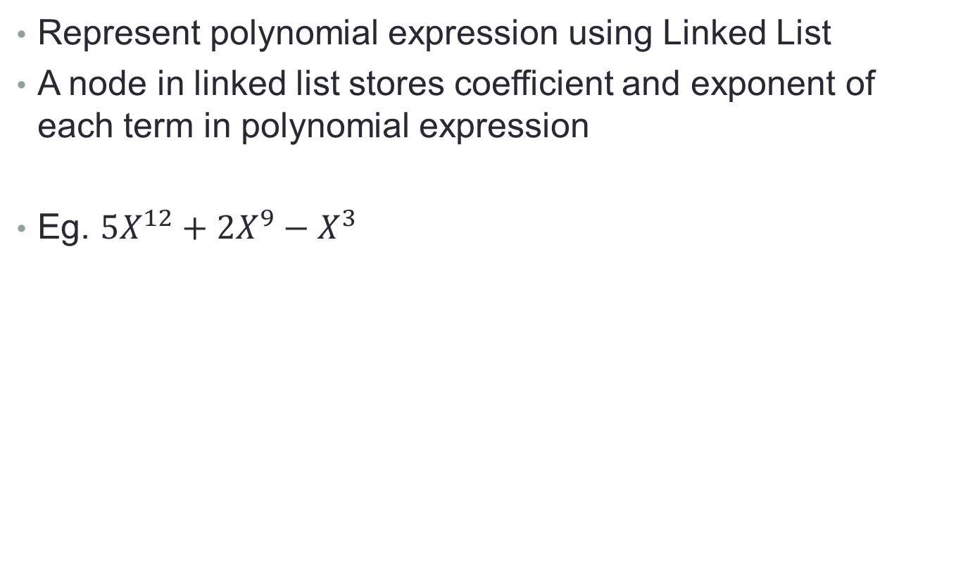
Polynomial Representation in LL
Represent polynomial expression using Linked List
A node in linked list stores coefficient and exponent of each term in polynomial expression
Eg. $5X^{12}+2X^{9}−X^{3}$
5
12
2
9
-1
3
NULL

Slide 64
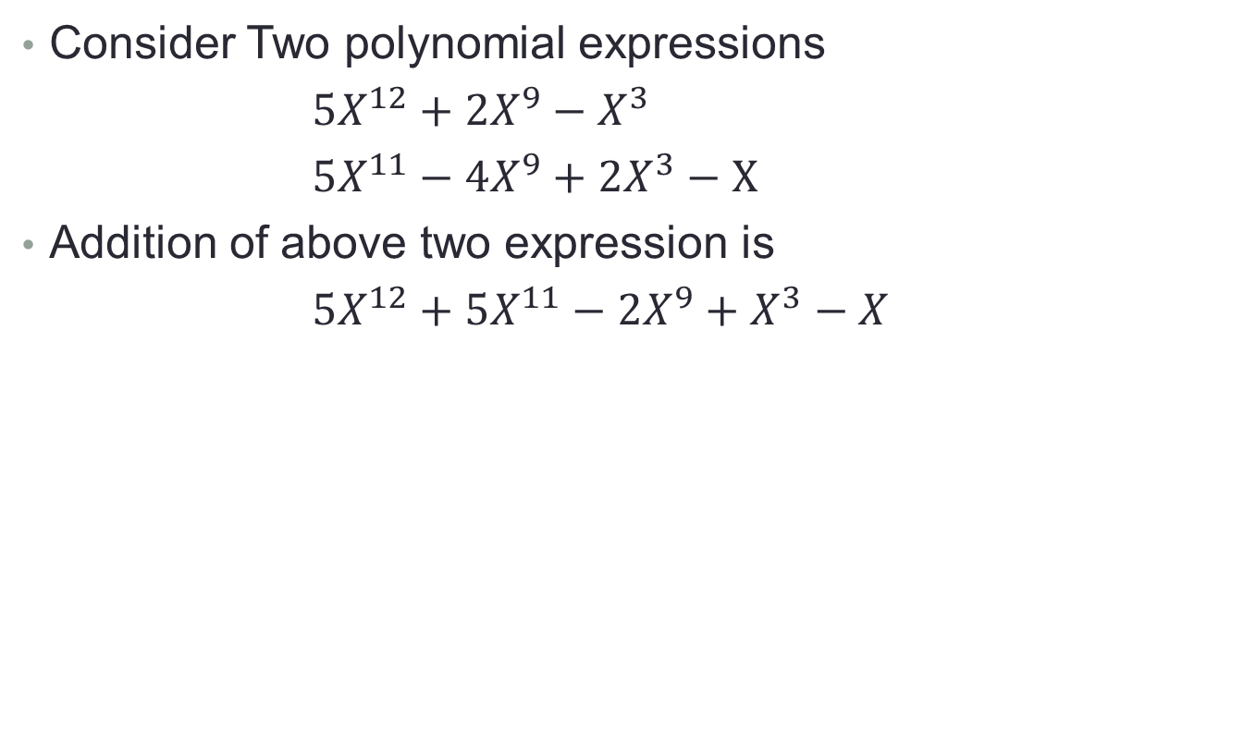
Polynomial Addition
Consider Two polynomial expressions
$5X^{12}+2X^{9}−X^{3}$
$5X^{11}−4X^{9}+2X^{3}−X$
Addition of above two expression is
$5X^{12}+5X^{11}−2X^{9}+X^{3}−X$

Slide 65
Algo for Polynomial Addition
Represent two polynomials in two linked lists L1 and L2
Create a third empty linked list L3
Compare the items in L1 with the items in L2
If there is no item having the same exponent, append these items to the third list.
If there are two items with the same exponent exp and coefficient coff1 and coff2, append an item with exponent exp and coefficient coff1+coff2 to L3

Slide 66
Pseudocode for Polynomial Addition
Polyadd(list L1, list L2, list L3)
while (L1 != NULL and L2 != NULL) //While both list are not empty
if (L1->pow > L2->pow) //if power of L1 is greater than L2, append L1 to L3
L3->coff = L1->coff; L3->pow = L1->pow;
L1 = L1->next;
if (L1->pow < L2->pow) //if power of L2 is greater than L1, append L1 to L3
L3->coff = L2->coff; L3->pow = L2->pow;
L2 = L2->next;
if (L1->pow = L2->pow) //if power of L1 & L2 is equal, add coefficient
L3->coff = L1->coff + L2->coff; L3->pow = L1->pow;
L1 = L1->next; L2= L2->next;
while (L1 != NULL) //if L2 has reached end, append remaining terms of L1
L3->coff = L1->coff; L3->pow = L1->pow; L1 = L1->next;
while (L2 != NULL) //if L1 has reached end, append remaining terms of L2
L3->coff = L2->coff; L3->pow = L2->pow; L1 = L2->next;

Slide 67
Example Polynomial Addition
L1
5
12
2
9
-1
3
NULL
L2
5
11
-4
9
2
3
-1
1
NULL
L3
NULL

Slide 68
Example Polynomial Addition
L1
5
12
2
9
-1
3
NULL
L2
5
11
-4
9
2
3
-1
1
NULL
L3
5
12
NULL

Slide 69
Example Polynomial Addition
L1
5
12
2
9
-1
3
NULL
L2
5
11
-4
9
2
3
-1
1
NULL
L3
5
12
5
11
NULL

Slide 70
Example Polynomial Addition
L1
5
12
2
9
-1
3
NULL
L2
5
11
-4
9
2
3
-1
1
NULL
L3
5
12
5
11
-2
9
NULL

Slide 71
Example Polynomial Addition
L1
5
12
2
9
-1
3
NULL
L2
5
11
-4
9
2
3
-1
1
NULL
L3
5
12
5
11
-2
9
1
3
NULL

Slide 72
Example Polynomial Addition
L1
5
12
2
9
-1
3
NULL
L2
5
11
-4
9
2
3
-1
1
NULL
L3
5
12
5
11
-2
9
1
3
-1
1
NULL

Slide 73
Circular Linked List(CLL)
Extension of Linear/Singly Linked List where last node points to beginning of list
Can be implemented in two ways
Header Pointer: An extra pointer pointing to start of list
Header Node: A special node in the beginning of list
Header node stores some special value, like a negative number if list contains only positive numbers
We can use flag to specify header and non-header nodes
CLL does not have any NULL pointer except for empty list

Slide 74
Circular Linked List (CLL)
Empty CLL
Non-Empty CLL
Header Node
ListStart
NULL
ListStart
5
9
6
-1
5
9
6

Slide 75
Traversing in CLL
void print(Eptr ListStart) {
Eptr temp = ListStart;
print (temp->data);
while (temp->next != ListStart) {
print (temp->data);
temp = temp->next;
}
}

Slide 76
Advantages of CLL
Some operations can be made efficient in CLL compare to Singly LL like search multiple entries subsequently
CLL are useful when element of lists are to be visited in “Loop” fashion

Slide 77
Insertion in CLL
Insert in Empty CLL
Change Header to point new node and new node to point itself
Insert at Start
Create new node; point to existing first node
Change last node to point to new node; change header
Insert in middle
Change new node to point successor of the node after which node is inserted
Change predecessor to point to new node

Slide 78
Deletion in CLL
Delete Last node
If node points to itself, set header to point to null
Delete from Front
Change last node to point second node in list
Update header to point to second node
Delete from middle
Change predecessor to point successor

